Slide 1
Cycling and weather
Hegyi Gáspár András

Slide 2
Outline
The data
Visualization and trends in the data
Defining clusters
Dependency on weather

Slide 3
The data I worked with
Hourly number of cyclists in Berlin
2017-2023
Drop values with lot of Nan
Missing values filled with daily average
Geographical data
Measuring point locations
Weather data
Filter for year
Precipitation, temperature, wind speed, hourly sunshine, humidity
Hourly sunshine missing values

Slide 4
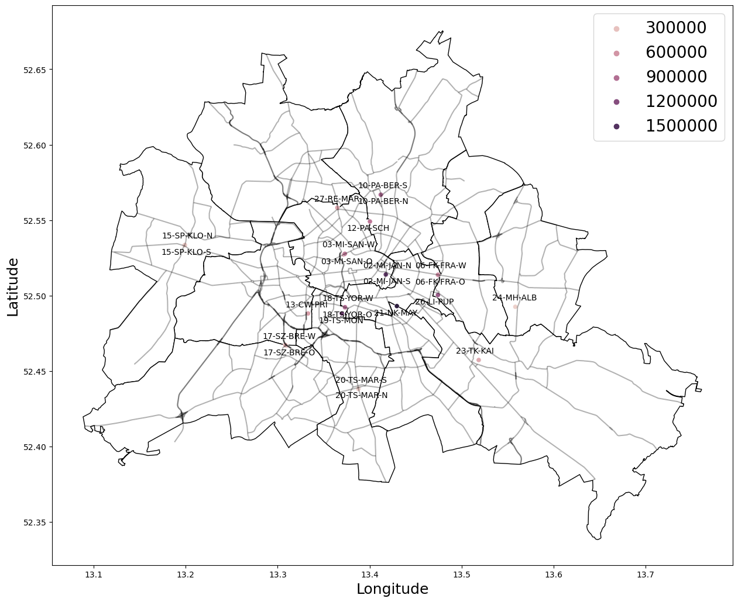

Slide 5
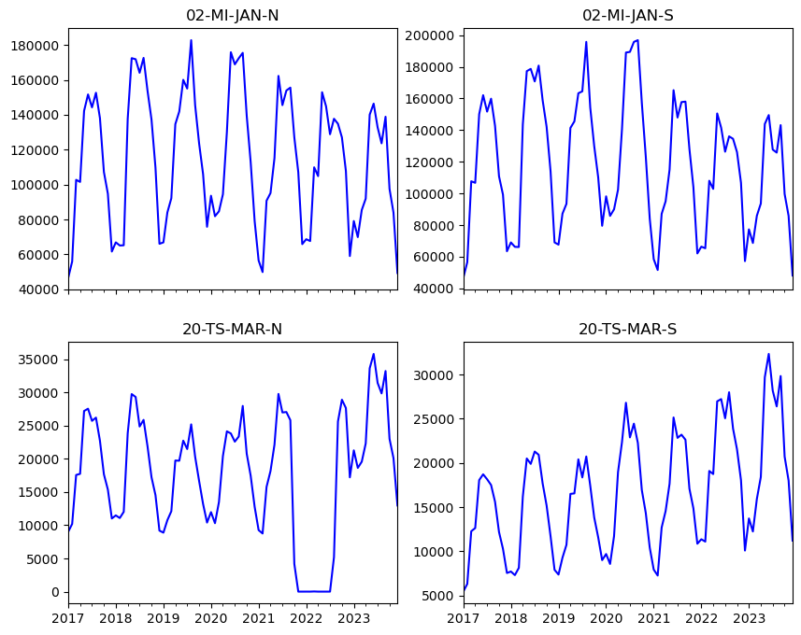
Yearly

Slide 6
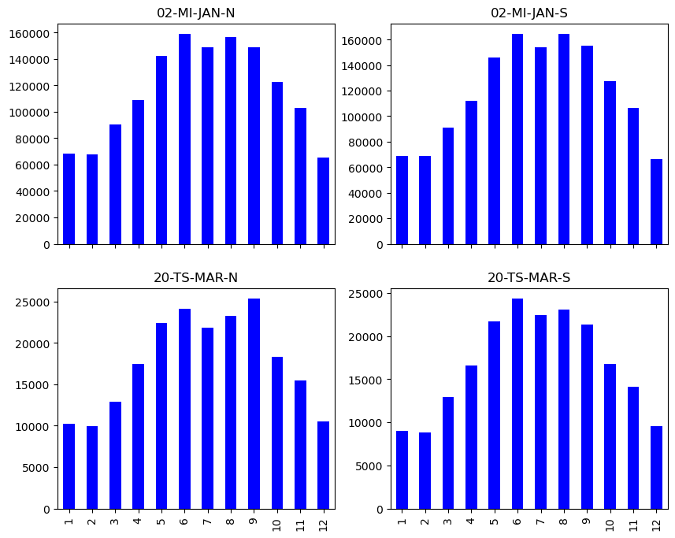
Monthly

Slide 7
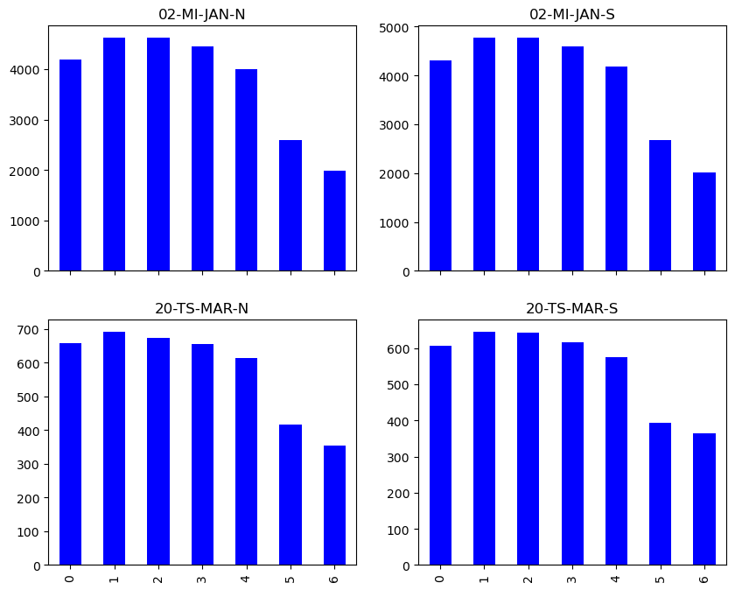
Weekly

Slide 8
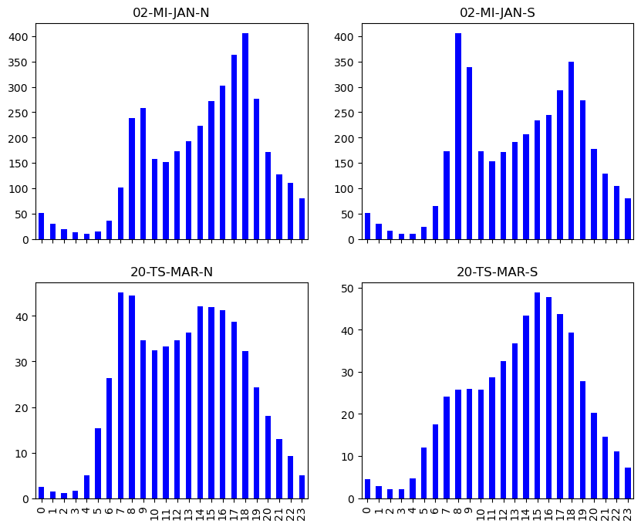
Hourly

Slide 9
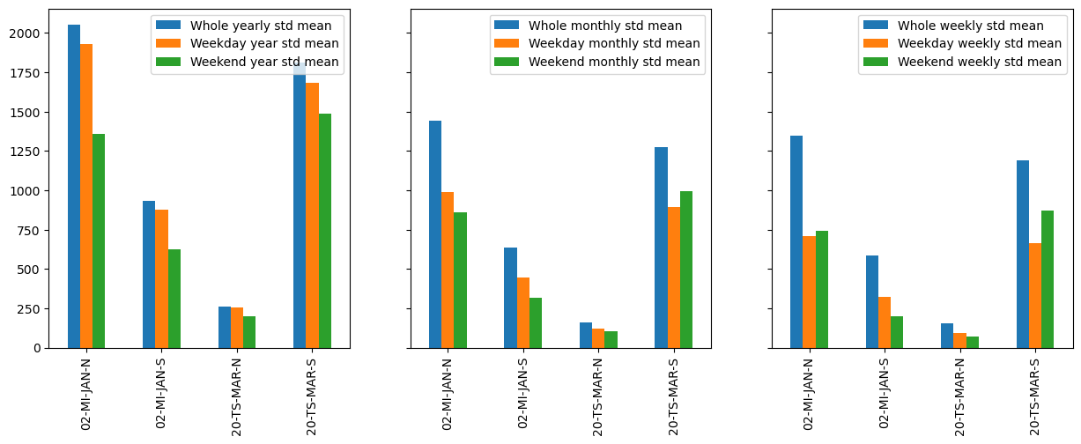
Separation of the data
Separated to weekends and weekdays to reduce dependency on week of the day

Slide 10
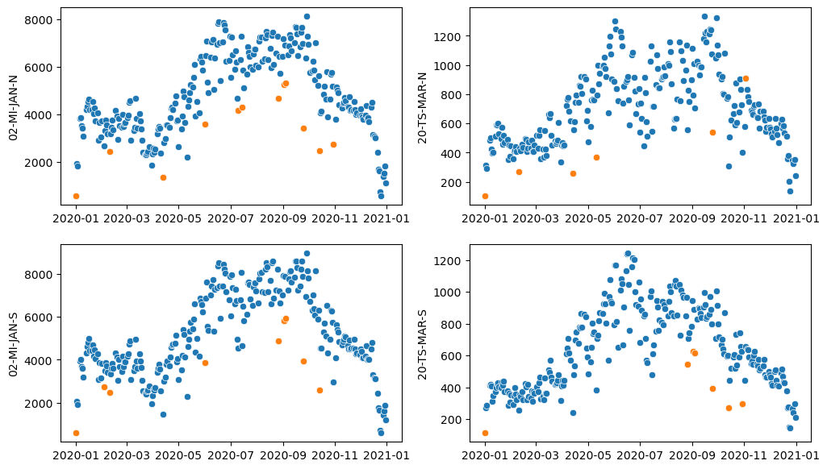
Outliers
By month, outliers would be lost in the yearly data
Separately for weekends and weekdays
Examples: New Year, BLM protest, COVID

Slide 11
Clustering
Hourly weather to daily
Avg: Temperature, wind speed, humidity
Sum: Sunshine, precipitation
Train on the weekday data
Leave weekends as test
Goal was to separate bad and good weather
Good and bad weather hopefully influences the number of cyclists

Slide 12
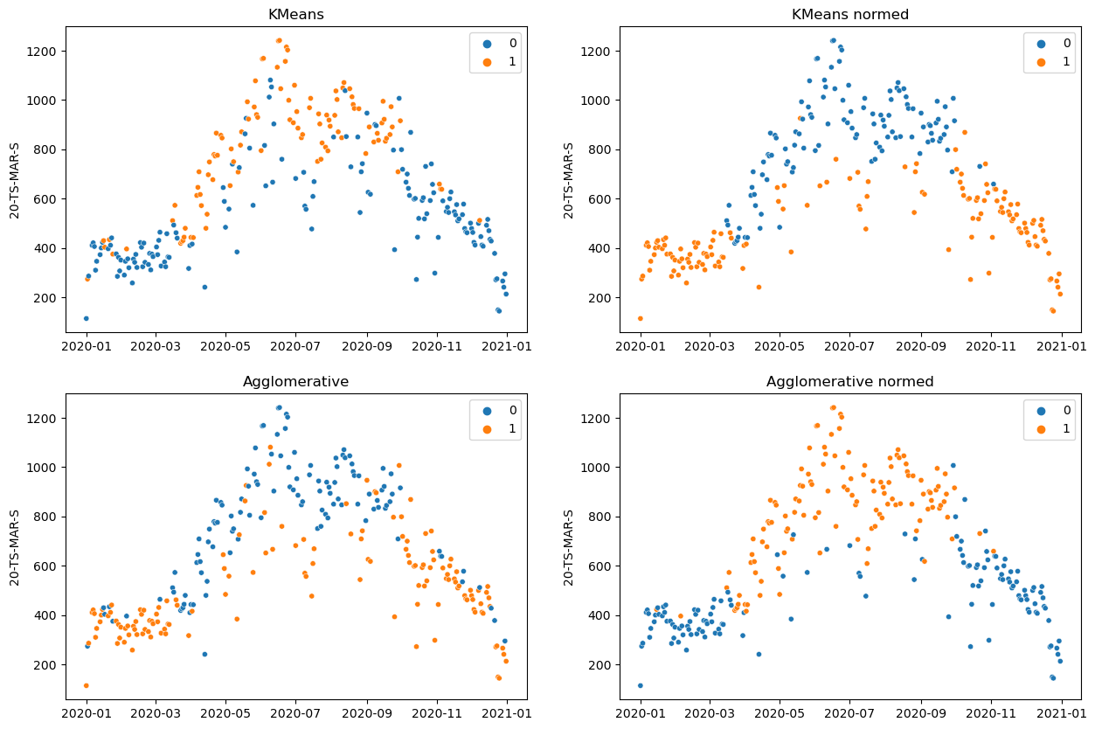

Slide 13
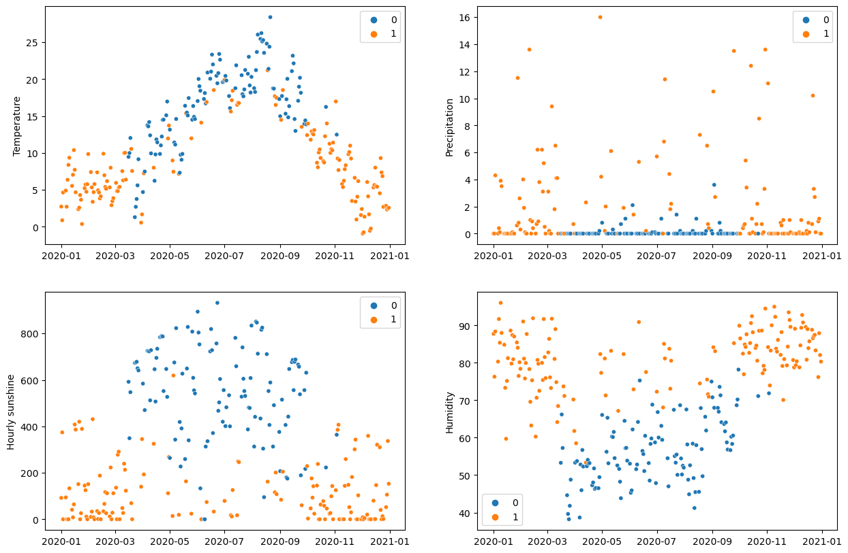

Slide 14
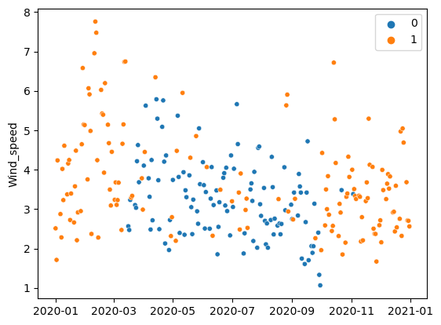

Slide 15
Supervised methods testing
Metric | Decision Tree | Random forests | Gradient boosted tree
Accuracy | 0.9711538 | 0.9807692 | 0.9711538
F1 | 0.9655172 | 0.9772727 | 0.9647058
Precision | 0.9545454 | 0.9555555 | 0.9761904
Recall | 0.9767441 | 1.0 | 0.9534883

Slide 16
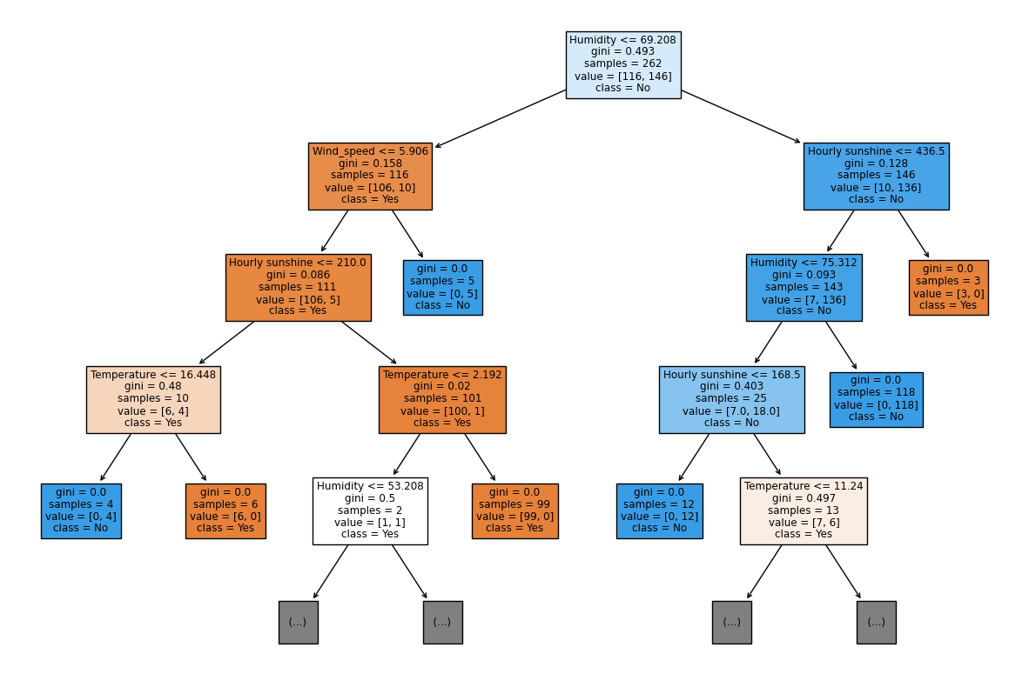
Decision tree

Slide 17
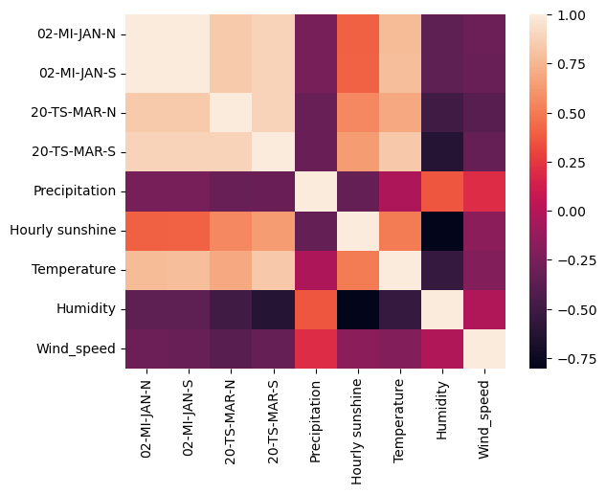
Weather dependency
Positive correleation
Temperature, hourly sunshine
Negative correlation
Wind speed, humidity, precipitaion

Slide 18
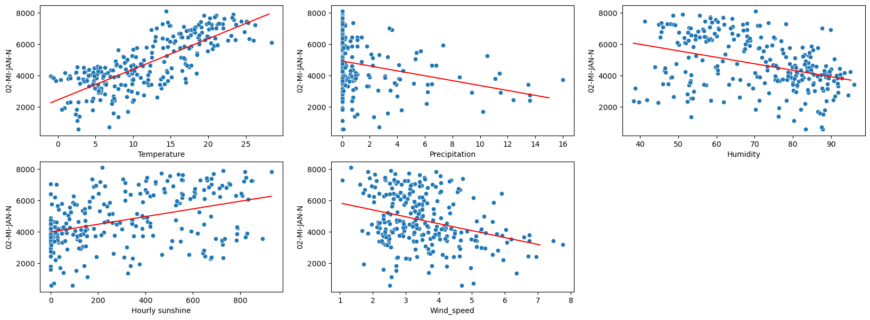
Individual features

Slide 19
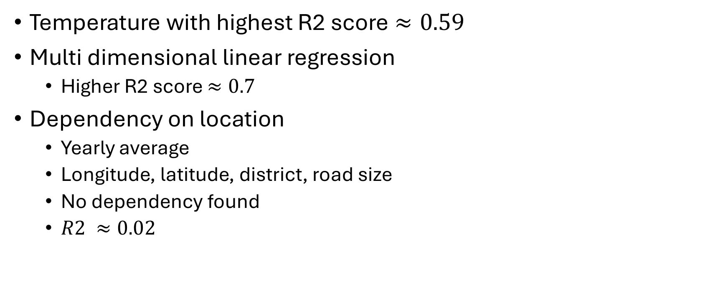
Accuracy of the fit
Temperature with highest R2 score $≈0.59$
Multi dimensional linear regression
Higher R2 score $≈0.7$
Dependency on location
Yearly average
Longitude, latitude, district, road size
No dependency found
$R2 ≈0.02$

Slide 20
Thank you for your attention

Slide 21
Dataset sources
https://ckan.mobidatalab.eu/dataset/wheel-number-data-in-berlin
https://app.mobilityhub.berlin/datasets/
https://daten.odis-berlin.de/
https://www.kaggle.com/datasets/mexwell/berlin-hourly-weather-data

